Slide 1
The importance of public relations
Michael foree
2020-01-18

Slide 2
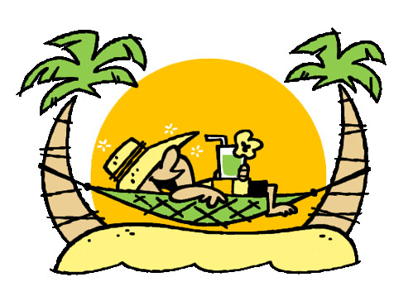
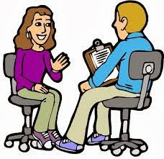
You are already developing public relation skills

Slide 3
Each team member is responsible for public relationships
Raising Money
Recruiting New Members
Procuring Parts
Developing Racing Strategy

Slide 4
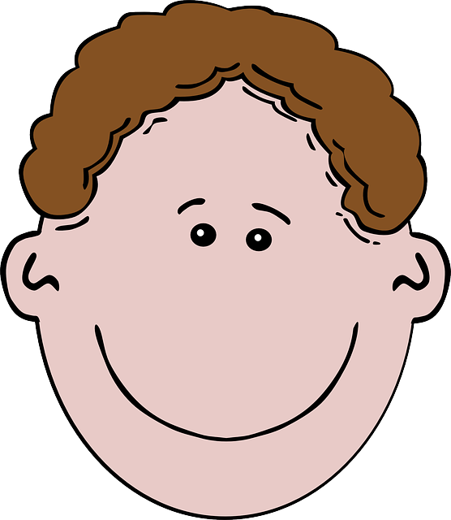
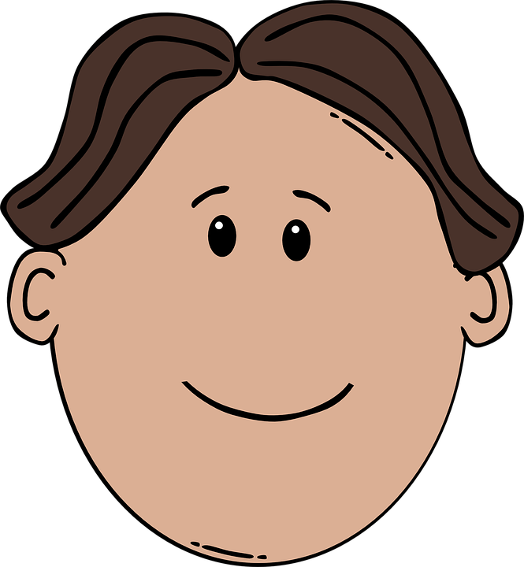
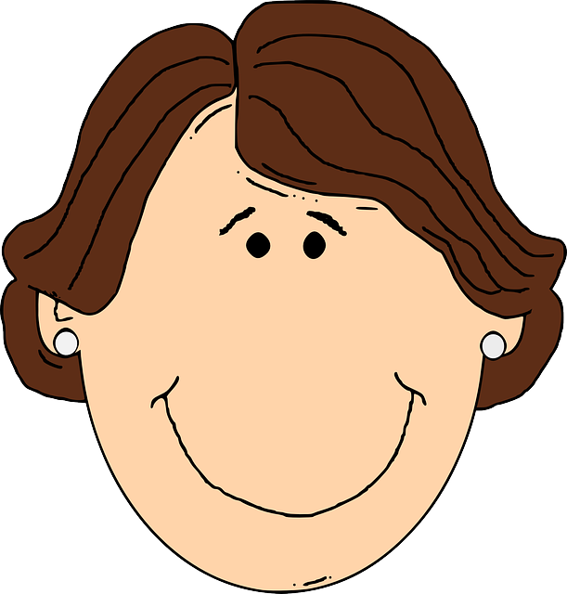
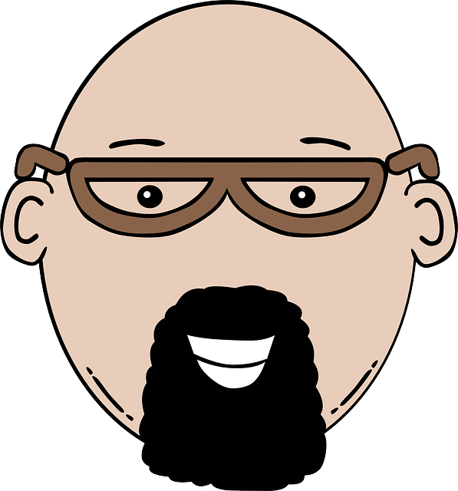
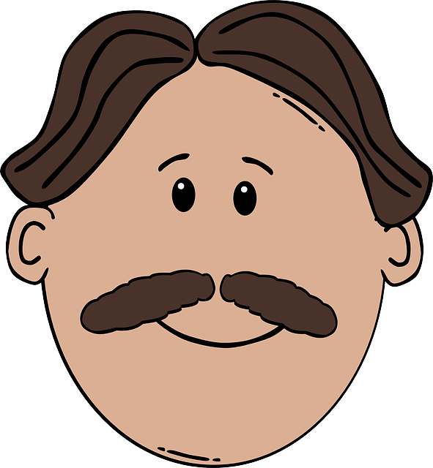
The Jaw-breaker Public relationship theory
YOU

Slide 5
When engaging others, follow these three steps
inform
Excite
advocate

Slide 6
Here are things you can start doing today
Once a year
Once a Month
Each Day
Develop a 2 minute response to the question “what is a solar car”
Develop pictures and charts to the question “what are you building”
Write a facebook post about “something that excited you”
Write a 2 line email about “what I did today” or “what I should have done today”

Slide 7
Next Steps: What are you going to do to develop public relationship skills

